Slide 1
Anatomy and Physiology
Nervous System

Slide 2
Functions
To sense, interpret and respond to internal and external environmental changes
To maintain a steady state in the body

Slide 3
Structure
CNS – central nervous system
  brain (survives 4-6 minutes without 0₂ and glucose)
  spinal cord
PNS – peripheral nervous system

Slide 4
Central Nervous System

Slide 5
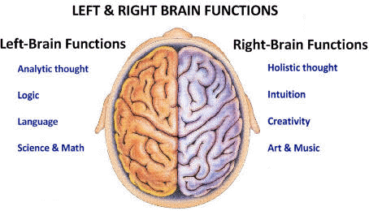
Brain
Cerebrum – two hemispheres (reasoning and senses) and 4 lobes

Slide 6
Brain Continued
parietal lobe - understanding speech , choosing words
Temporal lobe - hearing and understanding, speech and printed words, memory of music and visual scenes
Occipital lobe - vision and its interpretation

Slide 7
Peripheral Nervous System

Slide 8
Peripheral Nervous System
Twelve pair cranial nerves that originate from the brain
Thirty-one pair of spinal nerves that originate from the spinal cord and can act independently from the brain in some reflex reactions

Slide 9
Organs of the Peripheral Nervous System Contain
Voluntary or somatic
Involuntary or autonomic which has two parts
  sympathetic - stimulated in situations that require flight or fight reaction (stimulate heart rate, inhibit digestion)
  parasympathetic - functions in normal everyday situations (stimulate digestion, inhibit heart rate)

Slide 10
Synapse – Space between 2 neurons (1 millionth of an inch)
Neurotransmitter - more than 100. 2 important ones are
  acetylcholine
  norepinephrine

Slide 11
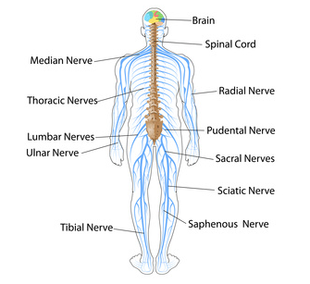
Nerves
Bundles of fibers that carry impulses

Slide 12
Assessment
Electroencephalogram (EEG)
  measures electrical activity of the brain
Lumbar puncture
  assesses cerebral spinal fluid
Myelogram
  X-Ray of the spinal cord (with contrast)

Slide 13
Disorders
Alzheimer's disease
  progressive loss of memory and intellectual impairment; no cure
Cerebrovascular accidents (CVAs)
  strokes
Down syndrome
  genetic disorder causes intellectual disabilities, short stature, neck, broad hands, stubby fingers and toes

Slide 14
Disorders Continued
Meningitis
  inflammation of the meninges caused by bacteria, virus or fungus characterized by headache, stiff neck, high fever, projectile vomiting, most are easily treatable
Multiple sclerosis
  degeneration of the myelin sheath resulting in defect of electrical transmission (no cure) usually strikes between 20 and 40 years of age

Slide 15
Disorders Continued
Parkinson's Disease
  progressive neurological disorder characterized by slow movement, tremor, and rigidity
Poliomyelitis
  a virus that spreads from the nose
  and throat to attack neural tissue
  (oral vaccine available)
Sciatica
  pain radiating from the back and
  buttocks down a leg

Slide 16
Disorders Continued
Spinal cord injury
  quadriplegia involves the cervical vertebrae
  paraplegia involves the lumbar vertebrae
  7,000 to 10,000 a year
  82% males between 15 to 25 years
Transient ischemic attacks (TIAs)
  mini-strokes

